Slide 1
DEATH ANALYSIS
Dipsa Prusty
dxp170230

Slide 2
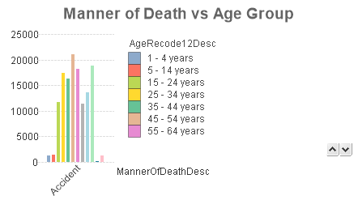
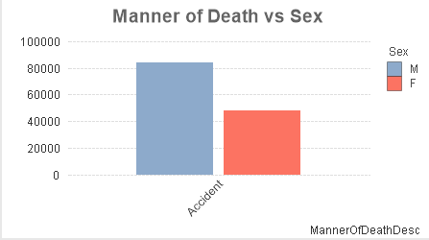
Findings
People dying in accidents are more for age group of 45 -54 years.
Death by accident is fairly higher for males.
.

Slide 3
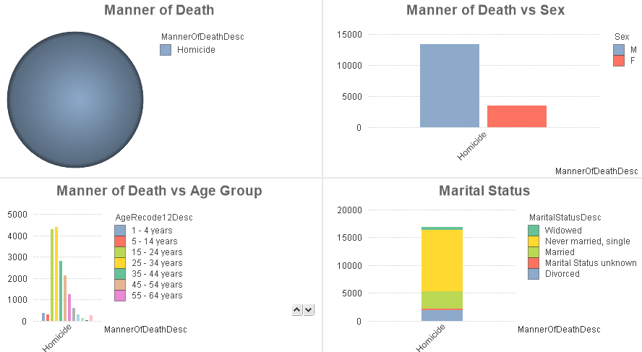
Findings
Majority of people died in homicide consists of youth(age group 15 – 34 years) and are unmarried males.

Slide 4
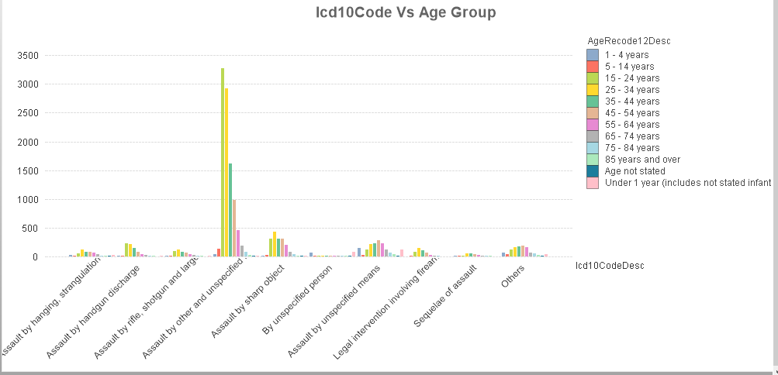
Findings
Reason of death of age group 15 – 24 years and 25 – 34 years is mostly from firearm discharge.

Slide 5
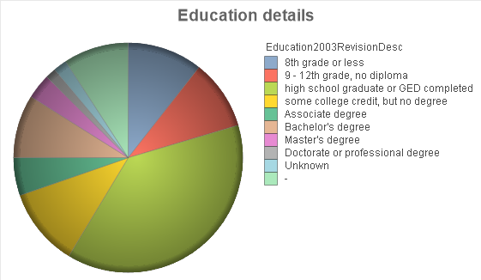
Findings
Death records are more for high school graduates.

Slide 6
Problems Faced
Number of times QlikView became unresponsive while building the front end of the application.
Loading script was very time taking while building the data model for the application.

Slide 7
Recommendations
Among the youth the usage of firearms and sharp objects are more. Measures should be taken to reduce its usage among them. Death Record also shows there are many high school graduates.
Accidents are more for males in the age group of 45 -54 years. Awareness should be spread to be more careful to avoid the unhappening.

